Slide 1
DYNAMIC LOAD BALANCING OF SDN CONTROLLERS USING OPENFLOW
Guided by: Dr. Rudra Dutta
Team Members:
Malayaz Sachdeva
Neha Sakhalkar
Rushikesh Agashe
Priya Asher

Slide 2
Introduction
Objective: Perform dynamic load balancing of Ryu Controllers for OpenFlow networks using the concept of a ‘Super-controller’
Motivation:
In today’s network scenario, there are thousands of switches in the network connected to millions of hosts which generate a multitude of requests per minute.
In SDN, these switches are connected to a Controller, which takes the forwarding decisions for these switches.
As a single controller handle requests from many switches, it is very likely for a controller to be overloaded at some point of time
Overloaded devices severely impact network performance, lead to delays and low network throughput
Dynamic load balancing for overloaded devices, thus, becomes essential

Slide 3
Project Outline
OpenFlow protocol used as the SDN southbound API to control the data plane.
Multiple controllers used to achieve network scalability
Load on an overloaded controller automatically transferred to an appropriate under-loaded controller with the help of a supercontroller
Individual controllers maintain their own load information
Periodically publish the flow-request information to the Super controller using a cross-controller communication system (every 2 seconds)
In the event of load imbalance detection on any controller, Supercontroller
Partitions the traffic
Re-allocates different flow-setups to transfer the load from that overloaded controller to other appropriate under-loaded controllers
Load balancing mechanism achieved using an automated mechanism, without administrator intervention

Slide 4
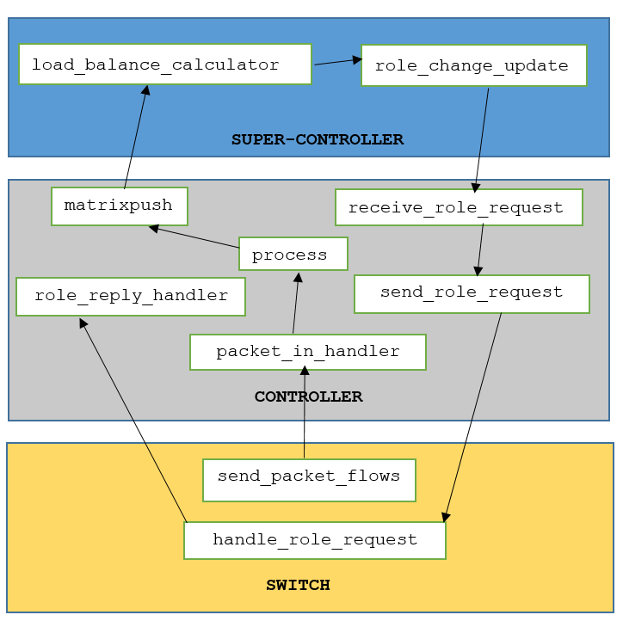
Low Level Design

Slide 5
Functions used in Controller and Supercontroller
load_balance_calculator: Function in Supercontroller that decides whether a controller is overloaded or not by comparing the controller load with the set threshold
role_change_update: Function in Super Controller that distributes the load among other controllers by requesting the other controllers to become master for a particular switch for a stipulated time in every time segment.
_packet_in_handler: Function in controller that handles incoming packets
send_role_request: Function in controller that requests switch to accept controller’s new role (MASTER / SLAVE / EQUAL)
role_reply_handler: Function in controller that handles switch’s response to the role request
Process: Function in controller that logs the number of flow requests received from each switch
Matrixpush: Function in controller that sends data to the supercontroller via a socket connection
receive_role_request: Function that receives the request from the Supercontroller to be MASTER for a particular switch based on the dpid

Slide 6
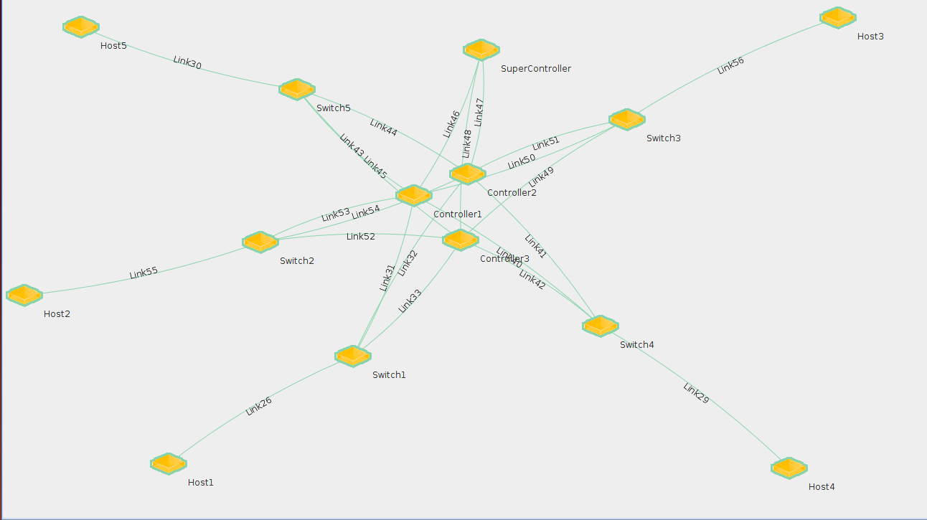
Demo Topology in ExoGENI

Slide 7
Demo Plan Setup
1 Supercontroller, 3 Controllers, 5 switches, 5 hosts
H1 – connected to S1
H2 – connected to S2
H3 – connected to S3
H4 – connected to S4
H5 – connected to S5
Ryu controllers
4 demo scenarios:
First 2 scenarios → Supercontroller inactive
Last 2 scenario → Supercontroller active

Slide 8
Demo Playbook
Before Load Balancing scenarios
Demo ID | Scenario | Expected Observation | Conclusion
1 | Supercontroller → inactive None of the controllers are overloaded. C1 → master controller for S1 C2 → master controller for S2 C3 → master controller for S3, S4 and S5 Generate below threshold dynamic requests (user-defined) for controllers from H1 and H2 in a period of 2 seconds by running script arping.sh at hosts. | 1. Wireshark output at Controller C1 → flow requests from S1 can be seen as well as the graph of flows (from S1) vs time shows that the Flow requests from S1 is below the predefined threshold value Wireshark output at Controller C2 → flow requests from S2 can be seen as well as the graph of flows (from S2) vs time shows that the Flow requests from S1 is below the predefined threshold value 2. Log at the controllers show that the number of flow requests received from their respective switches is below their predefined threshold levels. | When number of flow requests received by any controller from their respective switches is below the threshold value → controller functions properly (no overloading occurs)

Slide 9
Before Load Balancing scenarios
Demo ID | Scenario | Expected Observation | Conclusion
2. | Supercontroller → Inactive (supercontroller_average_calculation.py and supercontroller_collection_accumulation.py is not running at the super-controller) C1 → master controller for S1 C2 → master controller for S2 C3 → master controller for S3, S4 and S5 Controller C1 → overloaded C2-C3 → not overloaded Generate above threshold dynamic requests for C1 from H1 and generate below threshold for other controllers dynamic requests from hosts in the 2 second period by running script arping.sh at hosts. | 1. Wireshark output at C1 → flow requests from S1 can be seen as well as the graph of flows (from S1) v/s time shows that flow requests from S1 is now above the predefined threshold value of Controller C1 Wireshark output at C3 → flow requests from S4 can be seen as well as the graph of flows (from S4) vs time shows that flow requests from S4 is below the predefined threshold value of Controller C3 2. Log at controller C1 shows that the number of flow requests received is above the predefined threshold level. Log at controller C3 shows that the number of flow requests received is below the predefined threshold level. | Without Supercontroller, when the number of flow requests received by any controller exceeds the threshold value (determined by the maximum flow requests handling capacity of the controller), controller overloading takes place but no load balancing takes place

Slide 10
After Load Balancing Scenario
Demo ID | Scenario | Expected Observation | Conclusion
3. | Supercontroller → Active state C1 → master controller for S1 C2 → master controller for S2 C3 → master controller for S3, S4 and S5 (supercontroller_average_calculation.py is running at the super-controller) Controller C1 → overloaded C2-C3 → not overloaded Generate above threshold dynamic requests from H1 and generate below threshold dynamic requests from H4 in the 2 second period by running script arping.sh at hosts. Keep Wireshark running at Controller C1 and C3 from the previous scenario | Wireshark output at C1 → flow requests from S1 can be seen as well as the graph of flows (from S1) v/s time shows that the Flow requests from S1 has now gone below the predefined threshold value of Controller C1 over the time period. Wireshark output at C3 → Flow requests from S4 In addition to that, flow requests from S1 is also seen in gaps of certain time interval (in secs), also observed in the graph showing flows (from S1) vs time of the Wireshark output taken at C3 Flow requests from S1 are seen in gaps of certain time interval (in secs), also observed in the graph showing flows (from S1) vs time of the Wireshark output taken at the connected interface of Controller C2 | Supercontroller → Able to check whether any of the controller is overloaded or not. When controller overloading detected → Using the load balancing algorithm, Supercontroller is able to distribute the load in the ratio of loads at the controller by making one controller the Master for one time slice and another controller the Master for the next time slice and so on. Thus, Supercontroller is able to distribute the load from the overloaded controller to the other controllers in the network successfully.

Slide 11
Error Case (No load balancing possible)
Demo ID | Scenario | Expected Observation | Conclusion
4. | Supercontroller → Active C1 → Master controller for S1 C2 → Master controller for S2 C3 → Master controller for S3, S4, and S5 Controllers C1, C2 and C3 are overloaded. Generate above threshold dynamic requests from H1 Generate above threshold dynamic requests from H2 Generate above threshold dynamic requests from H4 | Wireshark output at Controller C1, C2 and C3 → Flow requests from S1, S2 and S4 can be seen on respective controllers as well as the graph of flow requests vs time shows that the flow requests from S1,S2,S4 are above the predefined threshold | When the load at all the controllers is above the threshold, the supercontroller is not able to perform any load balancing and successfully denied to perform load balancing for any controller

Slide 12
Thank You

